Slide 1
Parent Information
Meeting

Slide 2
Directors
Ms. Amy Darden: Director
Mrs. Laura Sirotti-Wong: Choreographer
Ms. Julie Terry: Assistant Director
All directors play an equal role and make decisions jointly

Slide 3
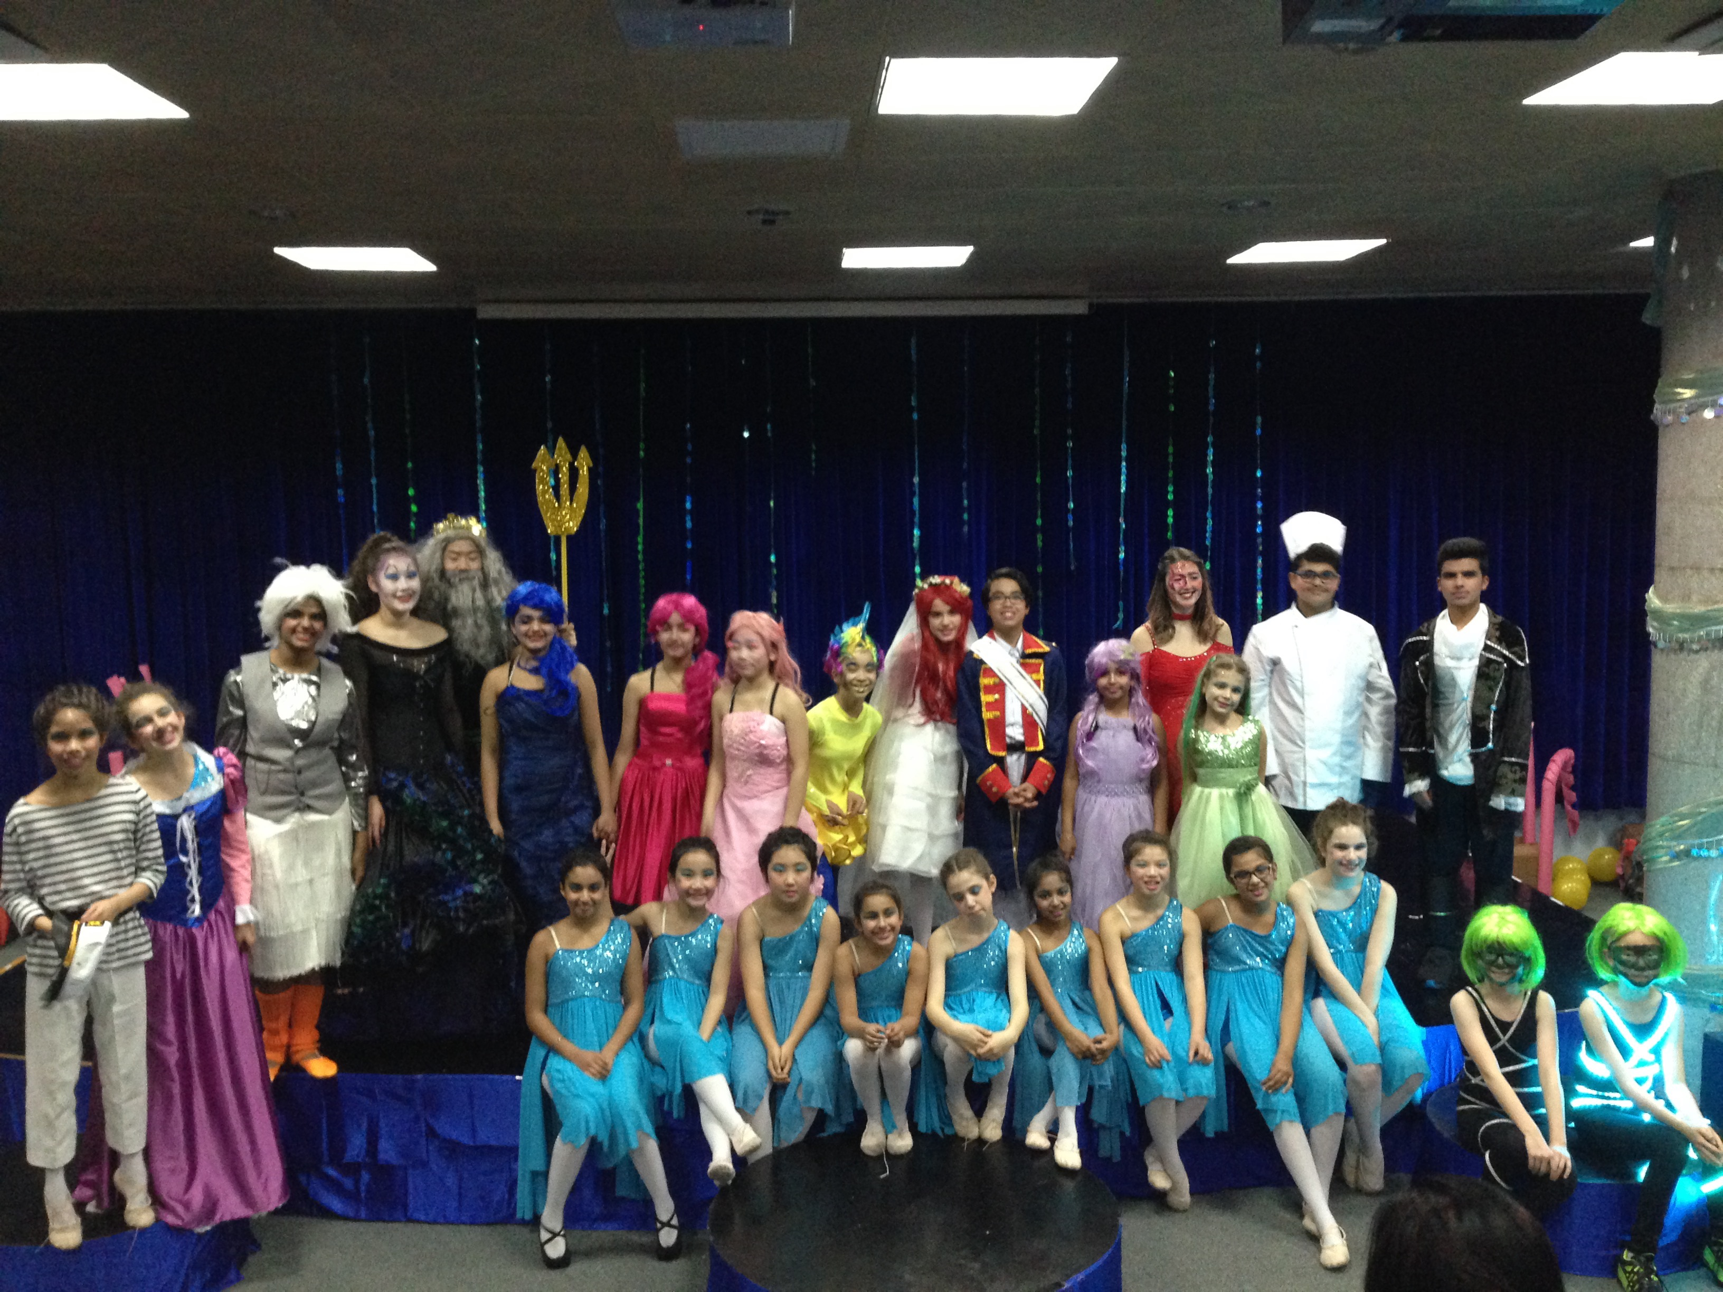
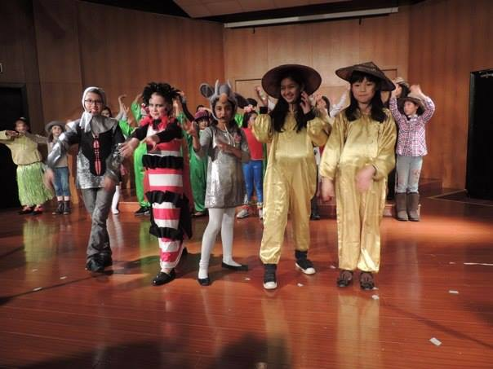
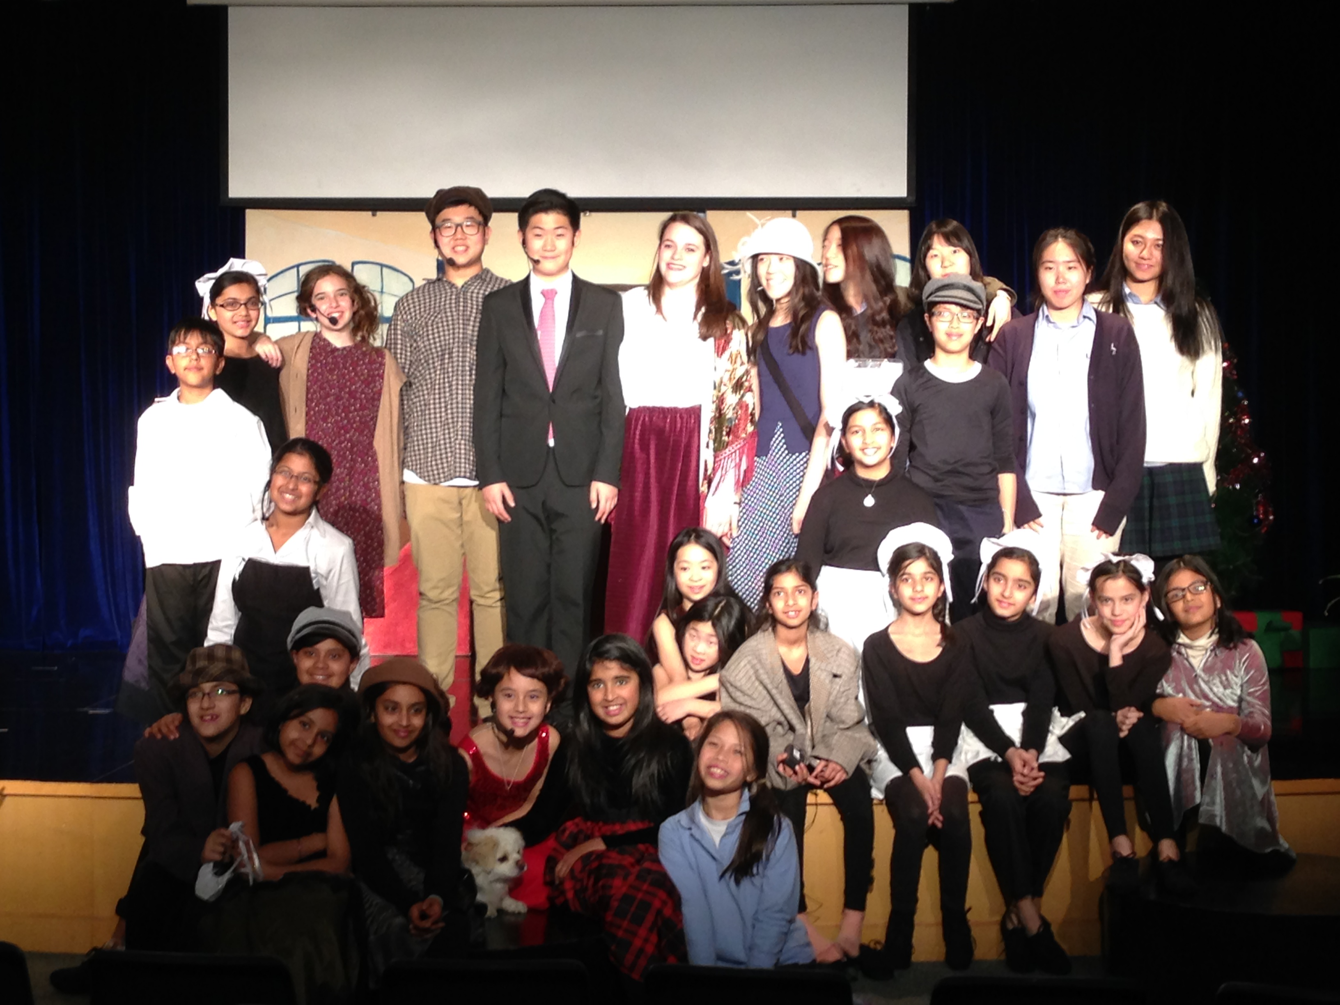
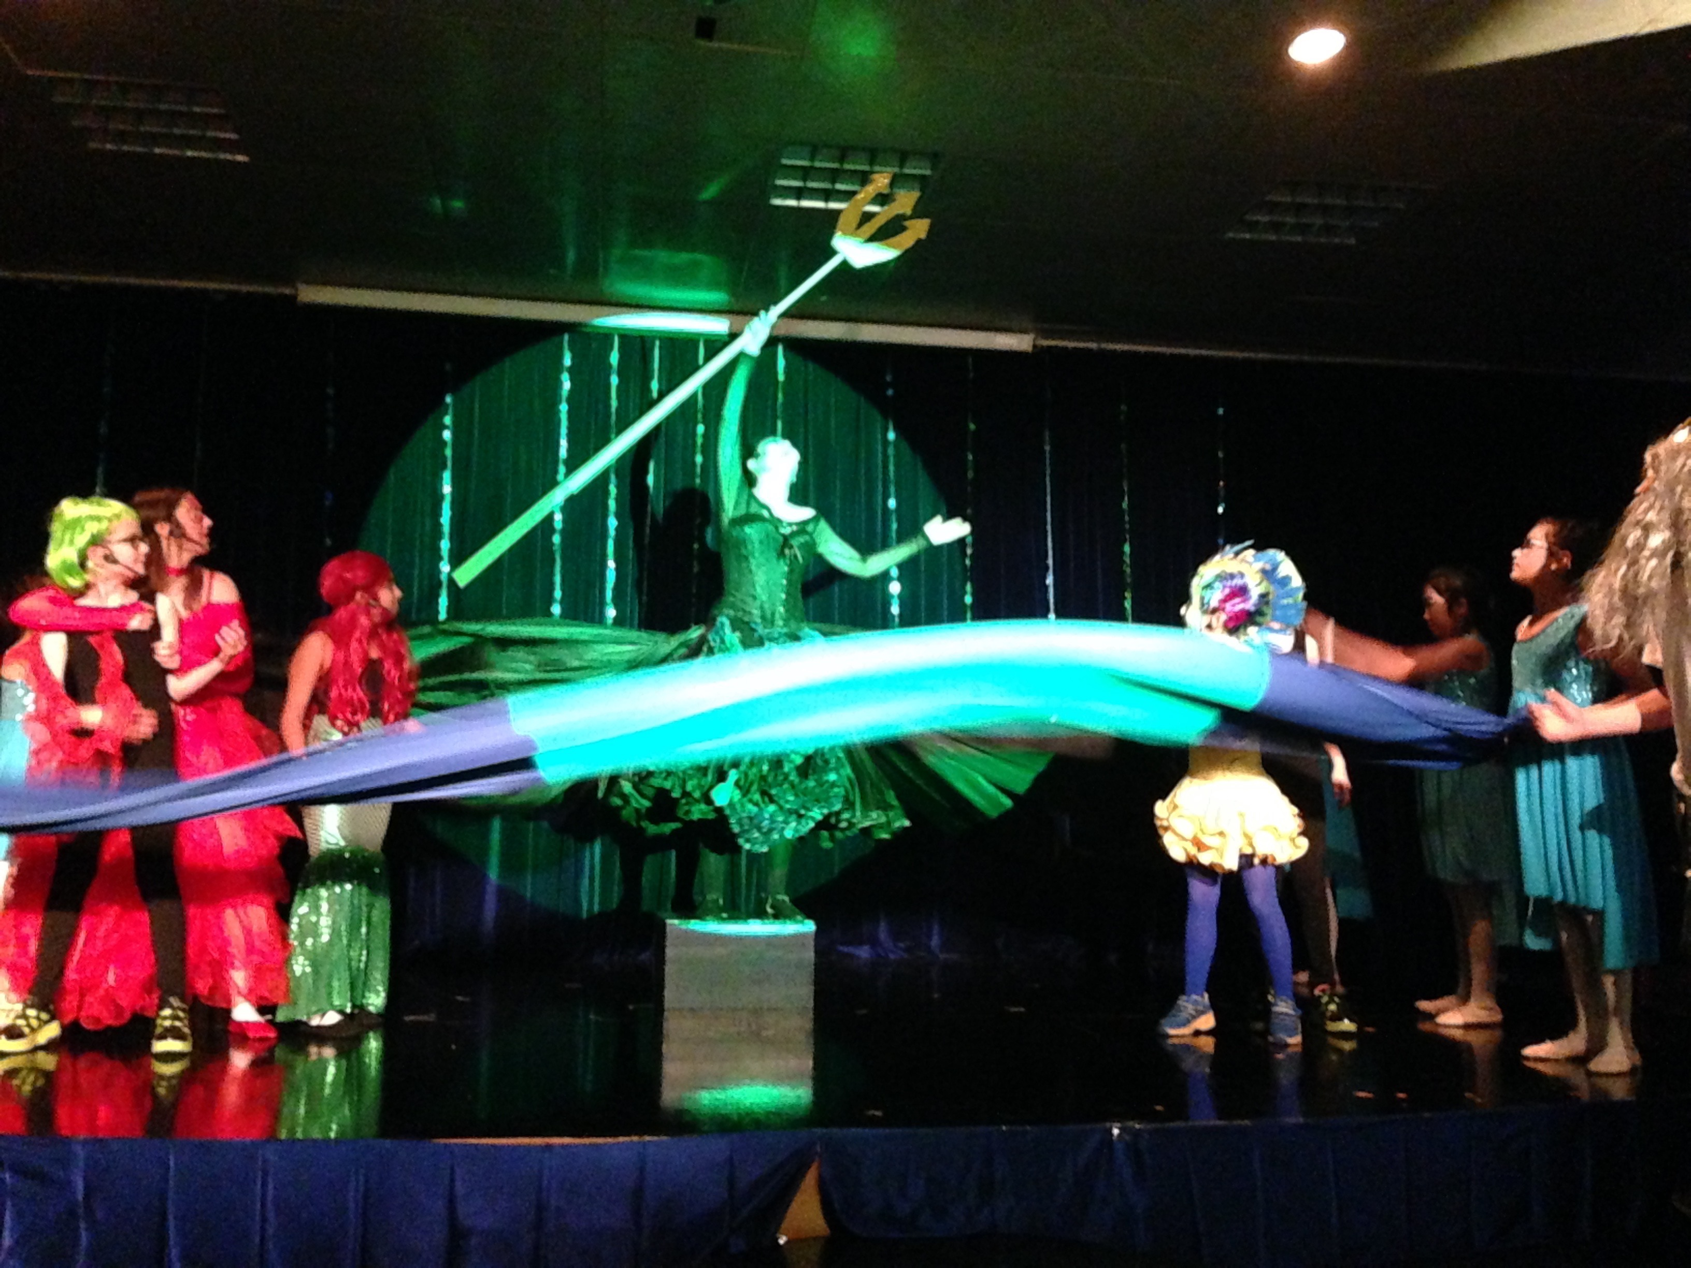
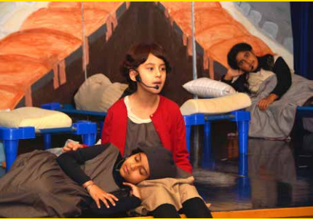
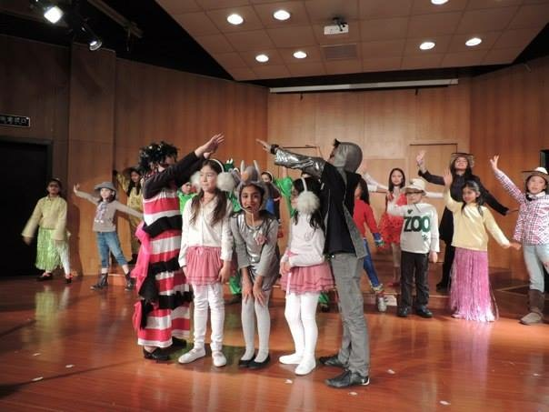
History of musicals at HIS
2013- Biomes
  2nd-5th grade; 25 members; non-auditioning; 2 quarter ASA
2014-Annie Jr
  26 member cast 2nd-12th grade
  first real musical at HIS
2015-The Little Mermaid Jr
  64 students auditioned!
  28 member cast; 10 member LS/US crew; 10 parent helpers
  first traveling theatre troupe; went to SCIS-HQ to perform

Slide 4
Being at this meeting is an achievement
We chose the cream of the crop and are very proud of the effort that you have put in so far.
Having said that, we have an alternate list—people we said “no” to who will replace you if you don’t pull your weight
If after this meeting, you realize that this is too much and you cannot commit, LET US KNOW KNOW! We will have no hard feelings if you tell us now

Slide 5
Schedule
Weekly Tuesday and Thursday all cast rehearsals
  Two leveled rehearsals:
      Music and Dancing
2 weeks before show: rehearsal daily (right after spring break)
Week of show, dress rehearsals until 5:30
Show dates: April 20 and 21
SLC-no rehearsal

Slide 6
Attendance
Students are expected to attend all rehearsals as scheduled by the Directors on the rehearsal schedule.
The only accepted excuses for missing a scheduled rehearsal is a full day absence from school or, for mainly upper school students (3-5th), a sanctioned HIS event (MUN, sports, outreach or China Trips)
  You will NOT be excused from every rehearsal
  We will work with your schedules, but expect that the other teachers work with ours

Slide 7
Attendance Continued…
All absences must be submitted in writing (either a hand written note or an e-mail sent to all 3 directors)
Upon receiving the third un-excused absence, the student may be dismissed from the show by the Directors.
Detentions and Suspensions are considered un-excused absences and student will be subject to removal from the show.
Snacks need to be fast, we start promptly at 3:10

Slide 8
Preparation
Cast: bring dance shoes, pencil, script every day to rehearsal
Memorize all lines, songs by the end of January
Rehearse on YOUR OWN TIME!
The quality of the production is dependent on the adequate preparation and achievement of each student. When a lack of preparation or achievement is evident, the directors may place student on a probationary status pending improvement.

Slide 9
Behavior
Cellphones are prohibited during rehearsals and events: this is HIS policy. We can’t have in them in class and you can’t have them in rehearsal
Student will behave appropriately and responsibly at rehearsals and take direction cooperatively.
He/She will keep quiet during rehearsals (in the performance space and backstage), eat and drink only in designated areas, remain in assigned parts of the building, etc.
Student and parent/guardians understand upon inappropriate behavior, the Directors will place the student on probation or dismiss him/her from the show.

Slide 10
Behind the Scenes behavior
All cast and crew will help props, scenery, microphones, sound, lighting, curtains etc.
Students also understand appropriate times to touch props, scenery, microphones, sound equipment, lighting, curtains, etc.
Students will behave responsibly during the evenings of the productions and dress rehearsals by remaining quiet and cooperating with the Stage Managers, stage crew and parents or teachers supervision other areas.

Slide 11
Costuming
Student agrees to provide, at their own expense, costuming that they will retain. Some of their costumes will be provided for them.
Student agrees to care for costumes that are loaned or provided to them, and to return them promptly after the show in good condition.

Slide 12
Props
Set in a garage/backyard, please bring in any old outside toys that you don’t need back.
    Rollerblades
    Scooters
    Jump ropes
    Badminton
    bikes

Slide 13
Academics
It is expected that all students complete homework and attend school while participating in the production. At no time will participation in Dear Edwina be grounds for not completing assignments for school
  If Dear Edwina is used as an excuse for not completing assignments, students will forfeit one of their 3 absences to complete these assignments
Time during rehearsal, when student is not directly involved, may be used for homework and study.
Students who are on the school’s official “ineligible” list may not participate in the show.

Slide 14
Fees for Participation
300 RMBCast Member:
  150RMB
    Food during all performances
  150RMB
    Costumes pieces
    Dance shoes
    Set Pieces

Slide 15
Respecting our Time like We Respect Yours
We are volunteering our time to manage this production
  We are passionate about music, dance and theatre and are happy to share this time with you, but we expect that you all understand how much we are donating to Dear Edwina
HIS requires each teacher to perform 40 hours of ASAs per year
Each of us is donating over 100 hours of ASA contact time
  Does not include the hours of preparation that we each put into the show

Slide 16
So, please be respectful of the effort that we put in by…
Adhering to the expectations that we have set forth today
Students and parents, notifying us in a timely manner about absences
Parents, notifying us ASAP in the event that your family must leave the HIS community before our scheduled performances

Slide 17
First Rehearsal/Read through
Thursday, September 22 Students will need to bring:
  Pencil
  USB for music
  We will give everyone a script at this time

Slide 18
Final Acceptance Contract
Upon leaving today, you will receive a final acceptance contract for both parents and students to sign
If you accept your position in the Dear Edwina, you will sign this contact tonight and return it with your fee of 300RMB by the first rehearsal (Tuesday Sep 27

Slide 19
Questions and Comments
To respect everyone’s time, we ask only parents to ask questions at this time that pertain to the whole group, not individual family conflicts
Students will have the opportunity ask questions at the first rehearsal

